Slide 1
Chapter 2
Database System Concepts and Architecture

Slide 2
Chapter 2 Outline
Data Models, Schemas, and Instances
Three-Schema Architecture and Data Independence
Database Languages and Interfaces
The Database System Environment
Centralized and Client/Server Architectures
for DBMSs
Classification of Database Management Systems

Slide 3
Database System Concepts and Architecture
Basic client/server DBMS architecture
  Client module
  Server module

Slide 4
Data Models, Schemas, and Instances
Data abstraction
  Suppression of details of data organization and storage
  Highlighting of the essential features for an improved understanding of data

Slide 5
Data Models, Schemas, and Instances (cont'd.)
Data model
  Collection of concepts that describe the structure of a database
  Provides means to achieve data abstraction
  Basic operations
    Specify retrievals and updates on the database
  Dynamic aspect or behavior of a database application
    Allows the database designer to specify a set of valid operations allowed on database objects

Slide 6
Categories of Data Models
High-level or conceptual data models
  Close to the way many users perceive data
Low-level or physical data models
  Describe the details of how data is stored on computer storage media
Logical data models
  Between high-level and low-level models
  Easily understood by end users

Slide 7
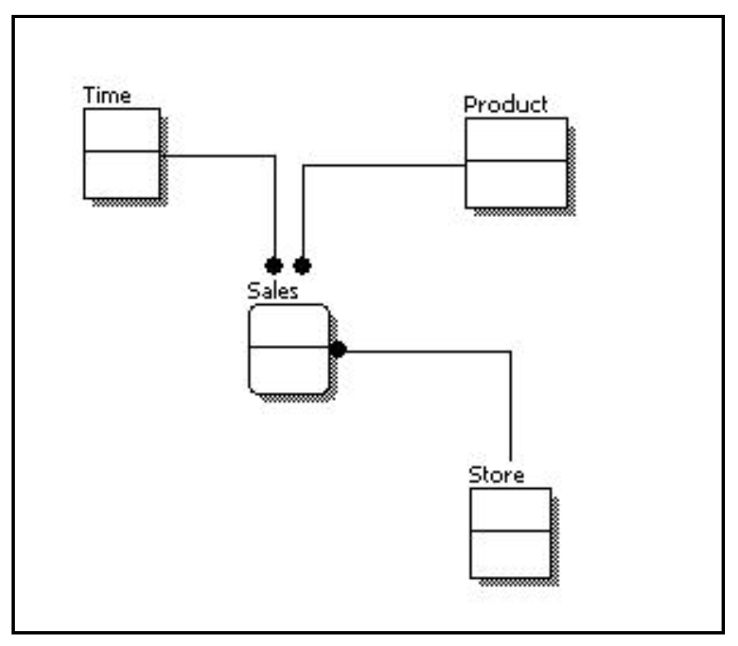
Conceptual data models

Slide 8
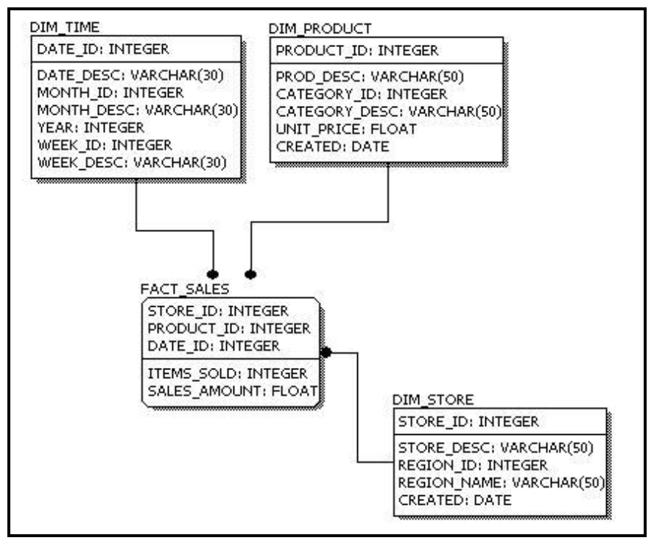
Physical data models

Slide 9
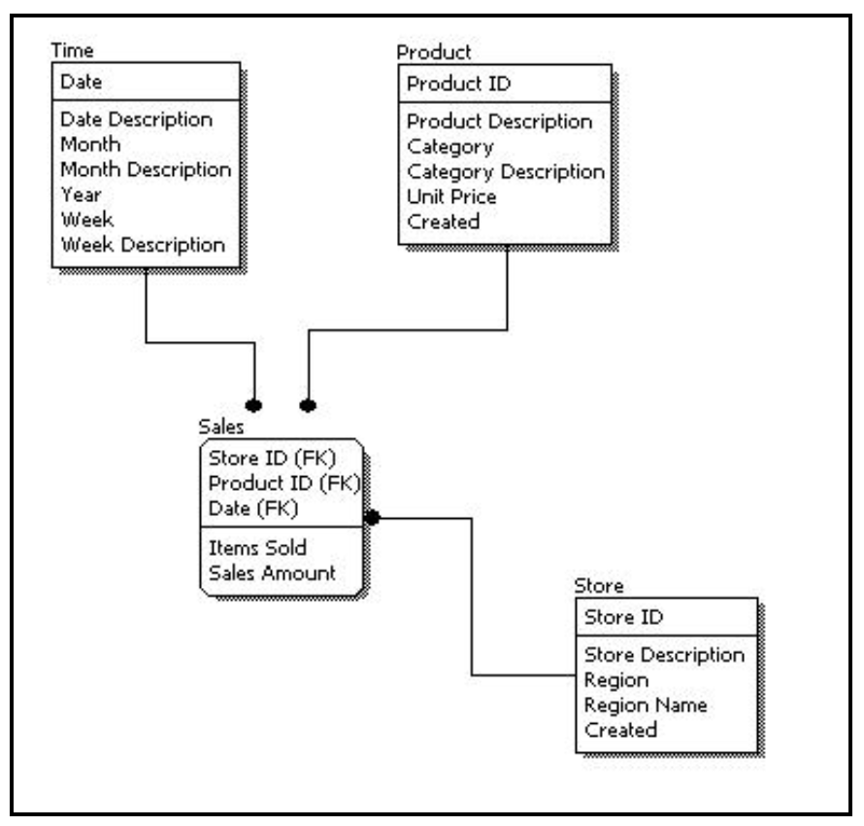
Logical data models

Slide 10
Categories of Data Models (cont'd.)
Entity
  Represents a real-world object or concept
Attribute
  Represents some property of interest
  Further describes an entity
Relationship among two or more entities
  Represents an association among the entities
  Entity-Relationship model

Slide 11
Categories of Data Models (cont'd.)
Relational data model
  Used most frequently in traditional commercial DBMSs
Object data model
  New family of higher-level implementation data models
  Closer to conceptual data models

Slide 12
Categories of Data Models (cont'd.)
Physical data models
  Describe how data is stored as files in the computer
  Access path
    Structure that makes the search for particular database records efficient
  Index
    Example of an access path
    Allows direct access to data using an index term or a keyword

Slide 13
Schemas, Instances, and Database State
Database schema
  Description of a database
Schema diagram
  Displays selected aspects of schema
Schema construct
  Each object in the schema
Database state or snapshot
  Data in database at a particular moment in time

Slide 14
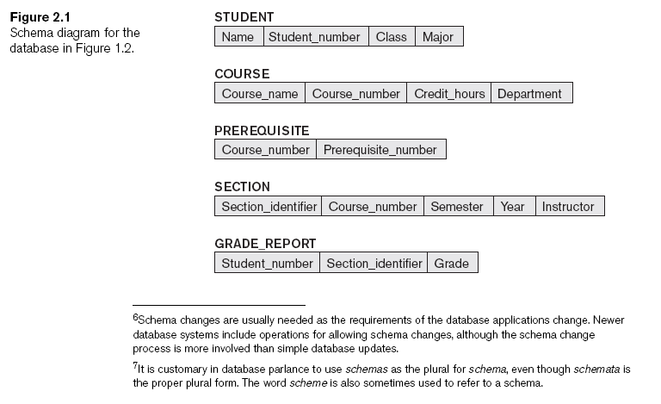
Schemas, Instances, and Database State (cont'd.)

Slide 15
Schemas, Instances, and Database State (cont'd.)
Define a new database
  Specify database schema to the DBMS
Initial state
  Populated or loaded with the initial data
Valid state
  Satisfies the structure and constraints specified in the schema

Slide 16
Schemas, Instances, and Database State (cont'd.)
Schema evolution
  Changes applied to schema as application requirements change

Slide 17
Three-Schema Architecture and Data Independence
Internal level
  Describes physical storage structure of the database
Conceptual level
  Describes structure of the whole database for a community of users
External or view level
  Describes part of the database that a particular user group is interested in

Slide 18
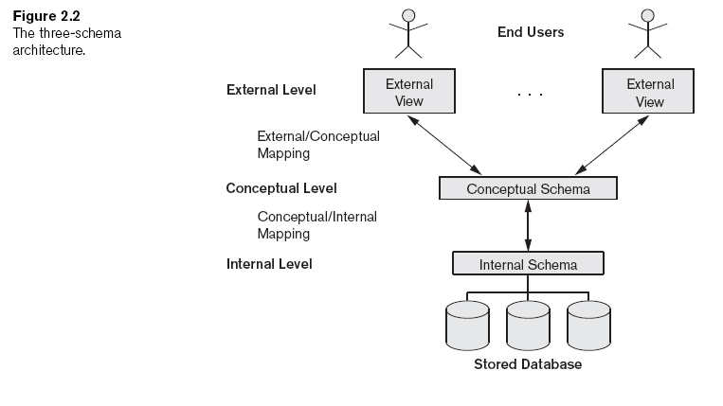
Three-Schema Architecture and Data Independence (cont'd.)

Slide 19
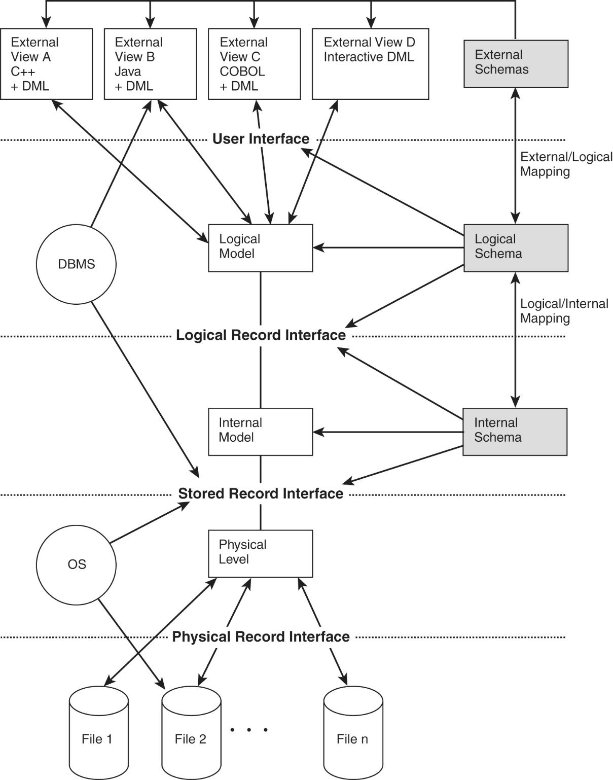
Three-Schema Architecture and Data Independence (cont'd.)

Slide 20
Data Independence
Capacity to change the schema at one level of a database system
  Without having to change the schema at the next higher level
Types:
  Logical: Immunity of external models to changes in the logical model, Occurs at user interface level
  Physical: Immunity of logical model to changes in internal model, Occurs at logical interface level

Slide 21
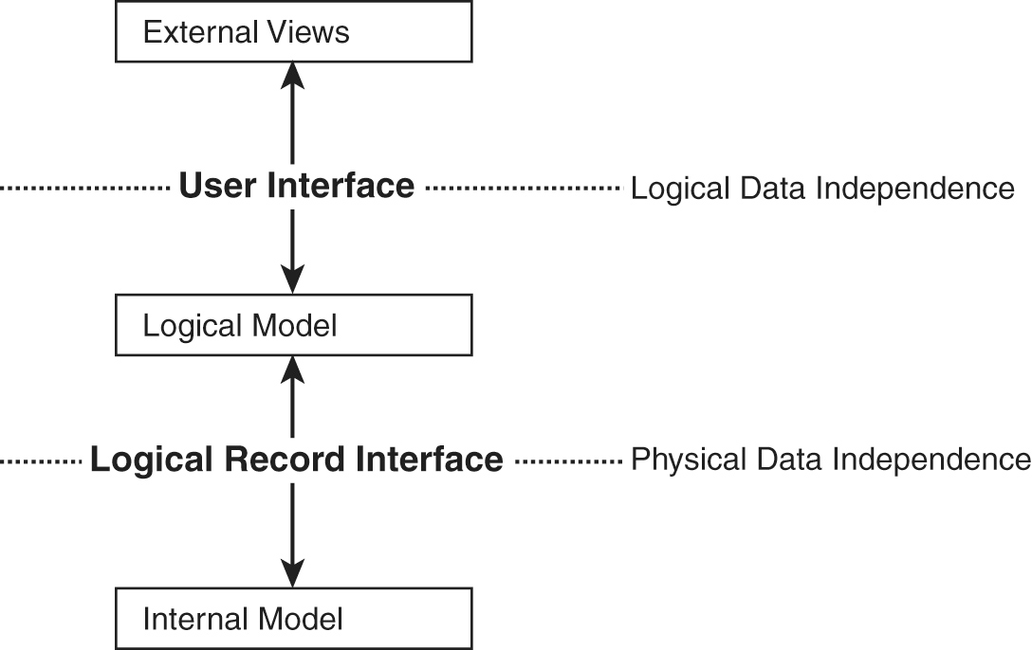
Data Independence (Cont’d)

Slide 22
DBMS Language: SQL
Data definition language (DDL)
  Defines both schemas
Data manipulation language (DML)
  Allows retrieval, insertion, deletion, modification
Data Control Language (DCL)
  Concerned with rights, permissions and other controls of the database system.
Transaction Control Language (TCL)
  Deals with transaction within a database.

Slide 23
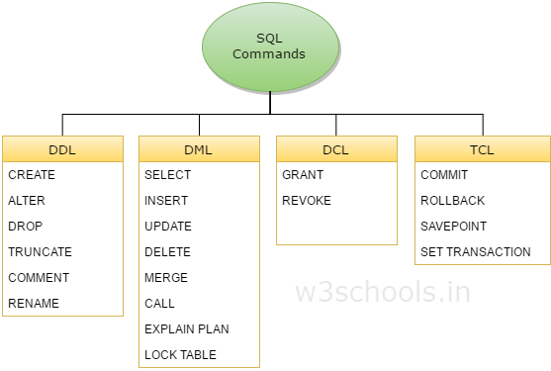
DBMS Language: SQL

Slide 24
DBMS Languages (cont'd.)
High-level or nonprocedural DML
  Can be used on its own to specify complex database operations concisely
  Set-at-a-time or set-oriented
Low-level or procedural DML
  Must be embedded in a general-purpose programming language
  Record-at-a-time

Slide 25
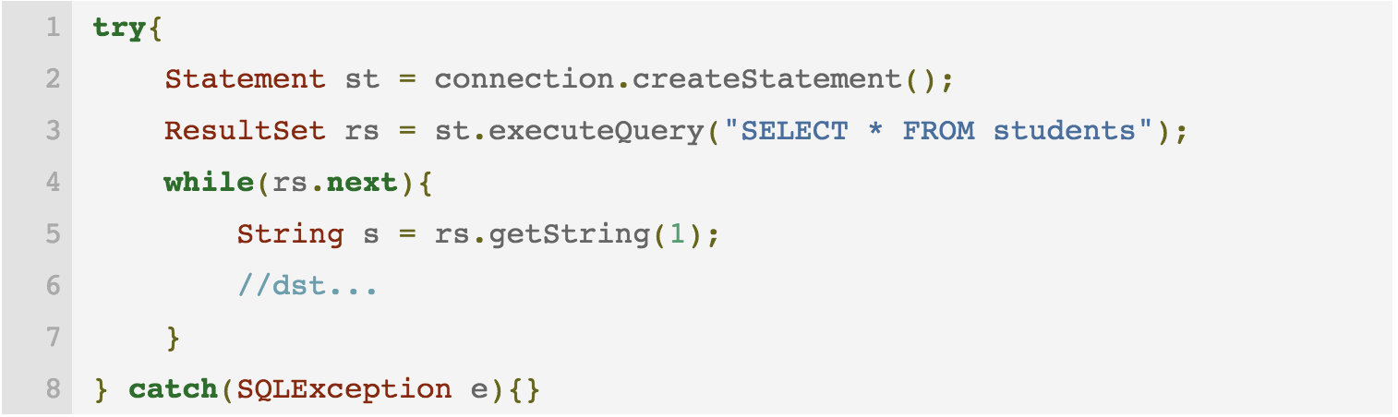
DBMS Languages (cont'd.)
Nonprocedural DML: the user only specifies what data is needed.
Procedural DML: the user specifies what data is needed and how to get it

Slide 26
DBMS Interfaces
Menu-based interfaces for Web clients or browsing
Forms-based interfaces
Graphical user interfaces
Natural language interfaces
Speech input and output
Interfaces for parametric users
Interfaces for the DBA

Slide 27
The Database System Environment
DBMS component modules
  Buffer management
  Stored data manager
  DDL compiler
  Interactive query interface
    Query compiler
    Query optimizer
  Precompiler

Slide 28
The Database System Environment (cont'd.)
DBMS component modules
  Runtime database processor
  System catalog
  Concurrency control system
  Backup and recovery system

Slide 29
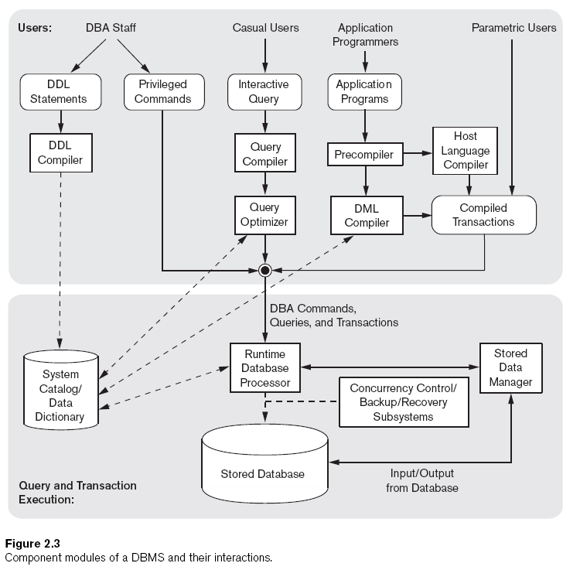

Slide 30
Database System Utilities
Loading
  Load existing data files
Backup
  Creates a backup copy of the database

Slide 31
Database System Utilities (cont'd.)
Database storage reorganization
  Reorganize a set of database files into different file organizations
Performance monitoring
  Monitors database usage and provides statistics to the DBA

Slide 32
Tools, Application Environments, and Communications Facilities
Computer-aided software engineering (CASE) tools
Data dictionary (data repository) system
  Stores design decisions, usage standards, application program descriptions, and user information
Application development environments
Communications software

Slide 33
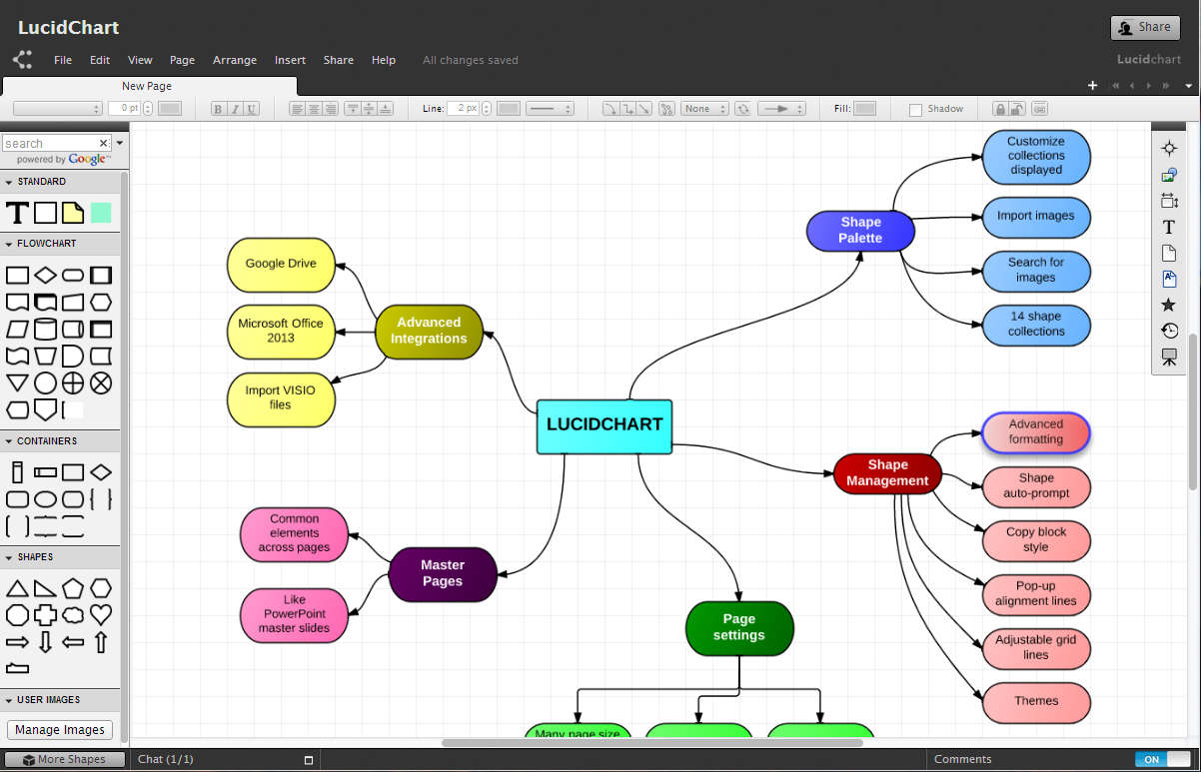
CASE Tools

Slide 34
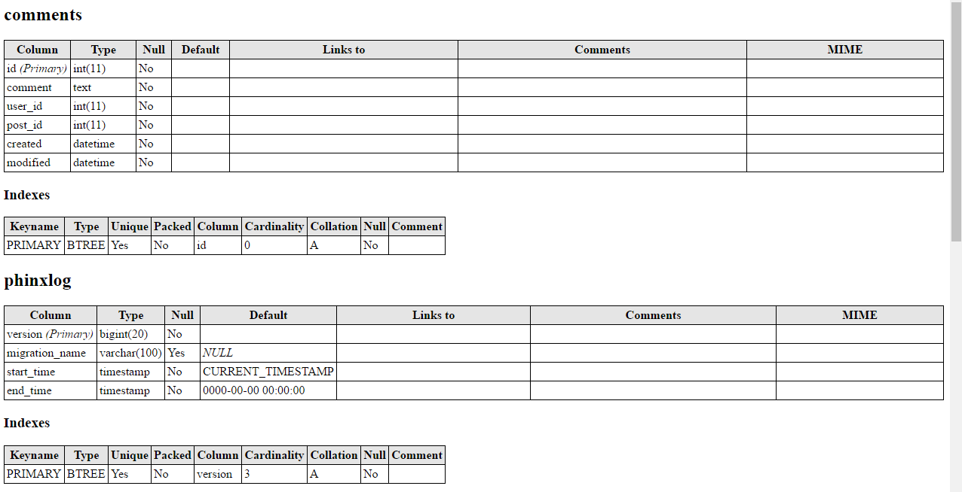
Data dictionary (data repository) system

Slide 35
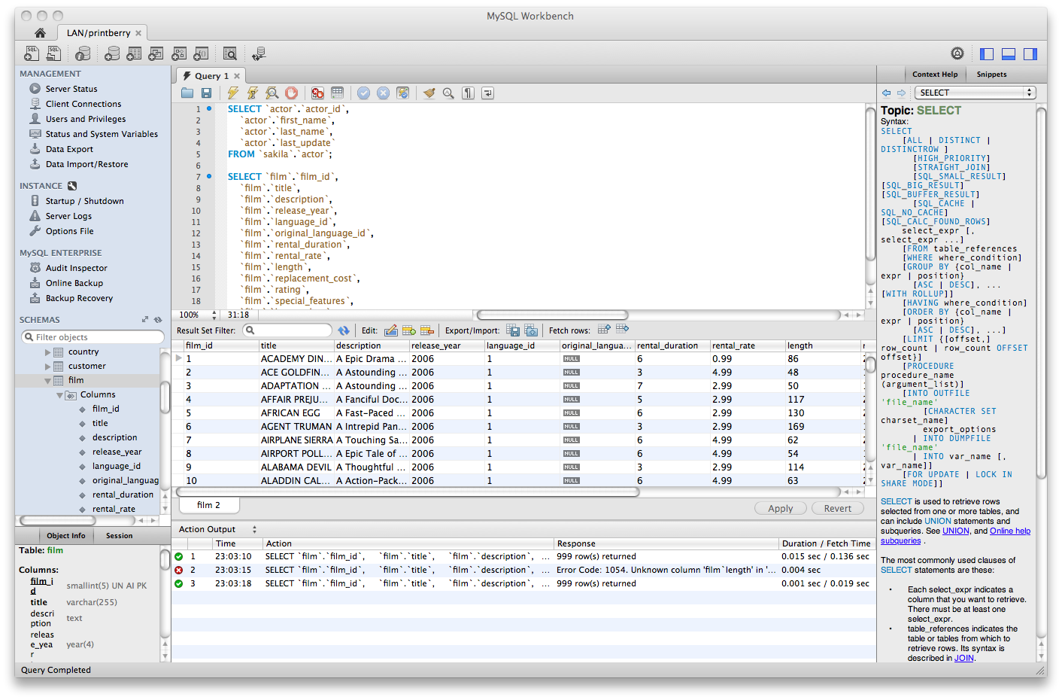
Application development environments

Slide 36
Centralized and Client/Server Architectures for DBMSs
Centralized DBMSs Architecture
  All DBMS functionality, application program execution, and user interface processing carried out on one machine

Slide 37
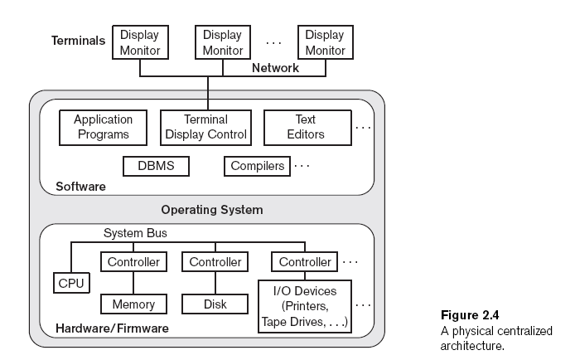

Slide 38
Basic Client/Server Architectures
Servers with specific functionalities
  File server
    Maintains the files of the client machines.
  Printer server
    Connected to various printers; all print requests by the clients are forwarded to this machine
  Web servers or e-mail servers

Slide 39
Basic Client/Server Architectures (cont'd.)
Client machines
  Provide user with:
    Appropriate interfaces to utilize these servers
    Local processing power to run local applications

Slide 40
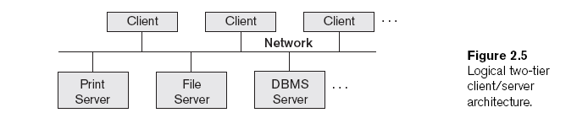
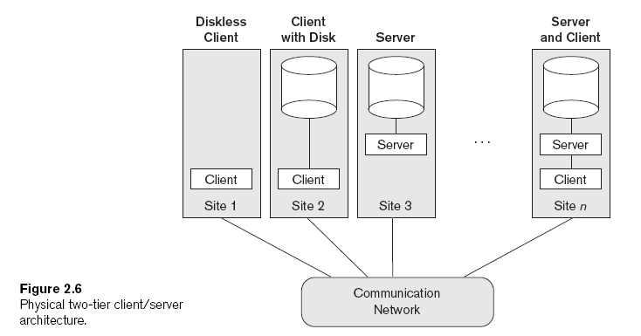

Slide 41
Basic Client/Server Architectures (cont'd.)
Client
  User machine that provides user interface capabilities and local processing
Server
  System containing both hardware and software
  Provides services to the client machines
    Such as file access, printing, archiving, or database access

Slide 42
Two-Tier Client/Server Architectures for DBMSs
Server handles
  Query and transaction functionality related to SQL processing
Client handles
  User interface programs and application programs

Slide 43
Two-Tier Client/Server Architectures (cont'd.)
Open Database Connectivity (ODBC)
  Provides application programming interface (API)
  Allows client-side programs to call the DBMS
    Both client and server machines must have the necessary software installed
JDBC
  Allows Java client programs to access one or more DBMSs through a standard interface

Slide 44
Three-Tier and n-Tier Architectures for Web Applications
Application server or Web server
  Adds intermediate layer between client and the database server
  Runs application programs and stores business rules
N-tier
  Divide the layers between the user and the stored data further into finer components

Slide 45
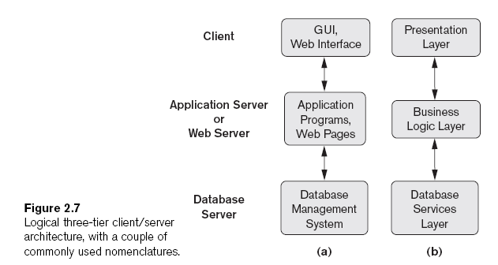

Slide 46
Classification of Database
Management Systems
Data model
  Relational
  Object
  Hierarchical and network (legacy)
  Native XML DBMS
Number of users
  Single-user
  Multiuser

Slide 47
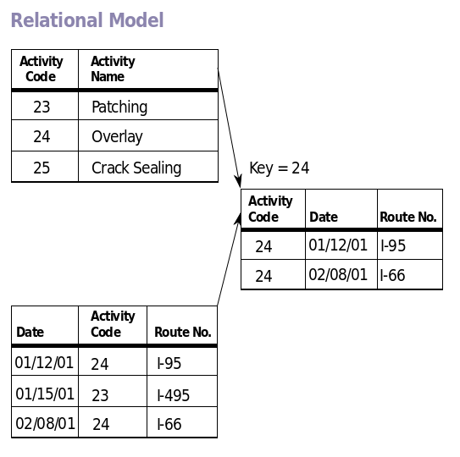
Relational Data Model

Slide 48
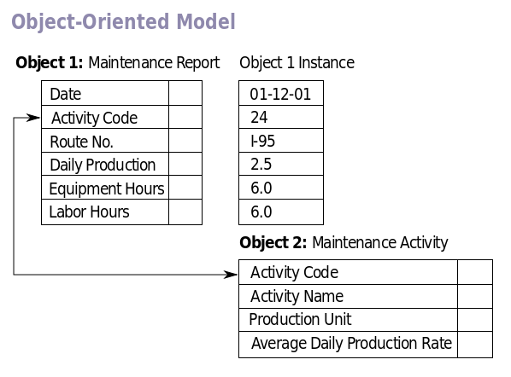
Object Data Model

Slide 49
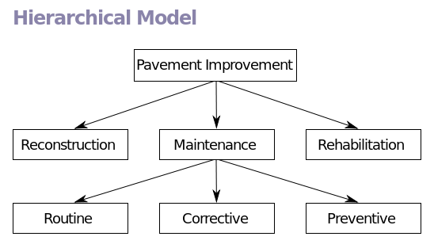
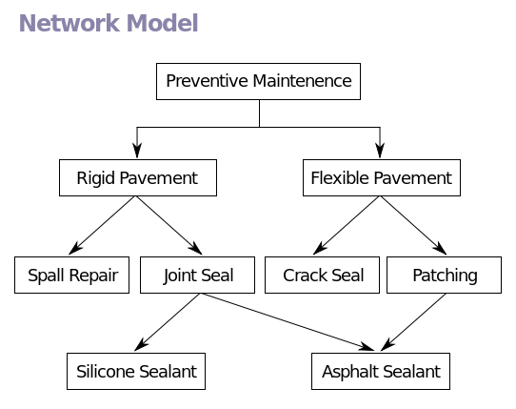
Hierarchical and network Data Models

Slide 50
Native XML DBMS
Native XML databases are databases that store XML documents.
Native XML databases are not based on tables, but on so-called containers. Each container may contain large amounts of XML documents or XML data, which have some relation between them.

Slide 51
Classification of Database
Management Systems (cont'd.)
Number of sites
  Centralized
  Distributed
    Homogeneous
    Heterogeneous
Cost
  Open source
  Different types of licensing

Slide 52
Summary
Concepts used in database systems
Main categories of data models
Types of languages supported by DMBSs
Interfaces provided by the DBMS
DBMS classification criteria:
  Data model, number of users, number of sties, access paths, cost

